Slide 1

Team: 2A1 (OLD482)
Traffic Object/Lane Detection
Critical Design Review
Notes:
Jason

Slide 2
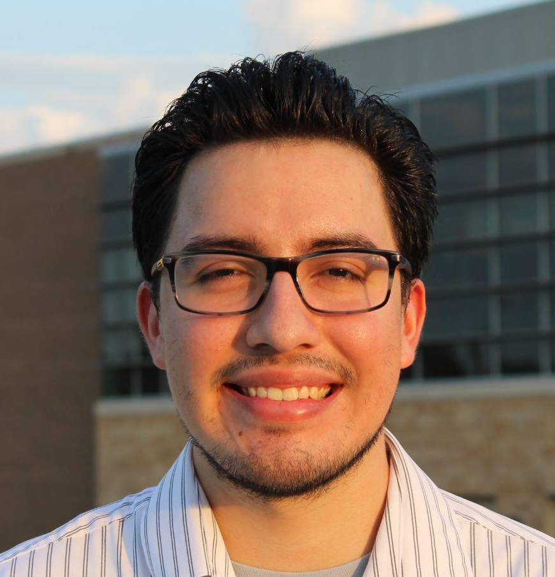





Jason Bernal
Pavan Poladi
Khai Nguyen
Viet Nguyen
Notes:
Jason

Slide 3
1
Problem Background
Notes:
Pavan

Slide 4



Frameworks:
Given nodes: Separate lane & object detection models
HybridNets: Joint detection models
New Pipeline:
Images -> ROS -> HybridNets -> ROS
Comparisons:
Accuracy & Speed
Usability & Robustness
Notes:
Pavan

Slide 5

Objectives/Requirements & How We Will Test Them
Have good understanding of ROS
Test: create sample publisher & subscriber
Test HybridNets’ joint detection model
Test: run model on BDD100K dataset
Compare ROS and Hybrid Net detection models
Test: run both on same datasets
Create pipeline To integrate HybridNet into ROS
Test: compare input and output at every step
Notes:
Pavan

Slide 6
2
Evaluation of Alternative Solutions
Notes:
Viet

Slide 7

Alternative Solutions
HybridNets released some level of ROS support on 10/11/2022
Open Neural Network Exchange (ONNX), an ML library.
Due to very recent release, the team will:
Run analysis on work
Abstract it to fit needs of project.
Statement from HybridNets
“This is awfully hard coded, so expect to change some strings and some numbers to make it work, or just open an issue”
Notes:
Viet

Slide 8

Alternative solutions cont.
Notes:
Viet

Slide 9



Alternative solutions cont.
Ground up
Brute Force
Fall back
Notes:
Viet

Slide 10
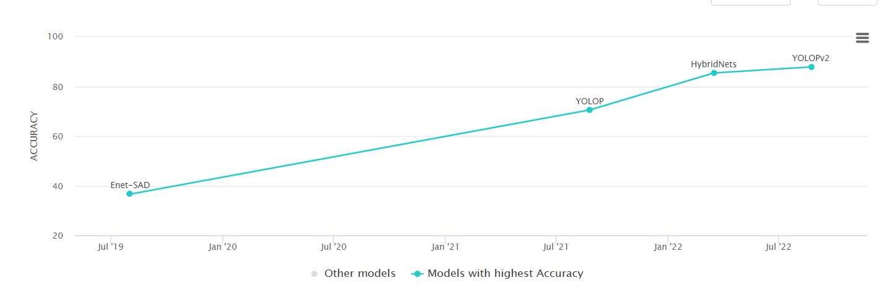
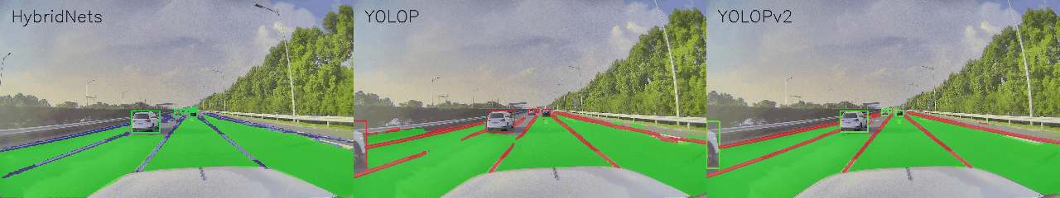
Last Alternative : YoloPv2
Notes:
Viet

Slide 11
3
System-Level Functional Description
Notes:
Khai

Slide 12
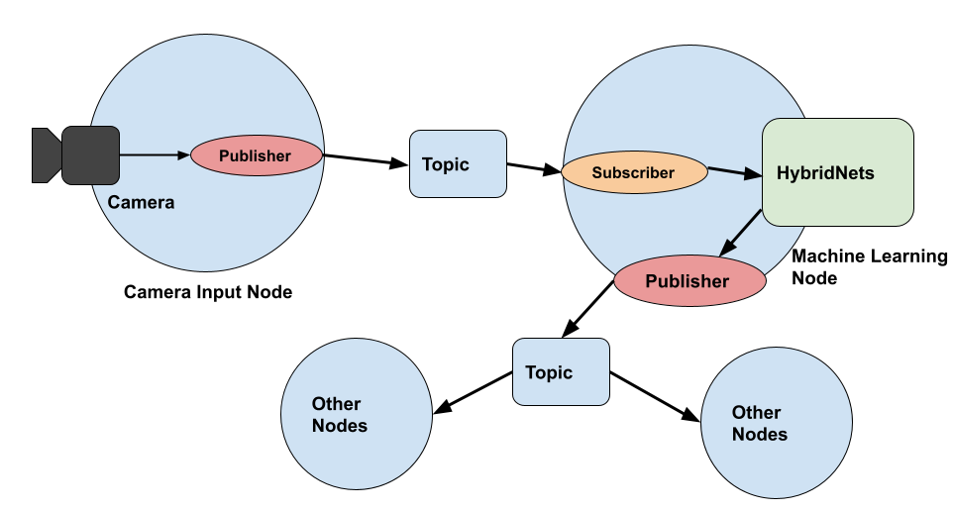
System-Level Architecture
Notes:
Viet

Slide 13
4
Designs of System Components & Interfaces
Notes:
Khai

Slide 14
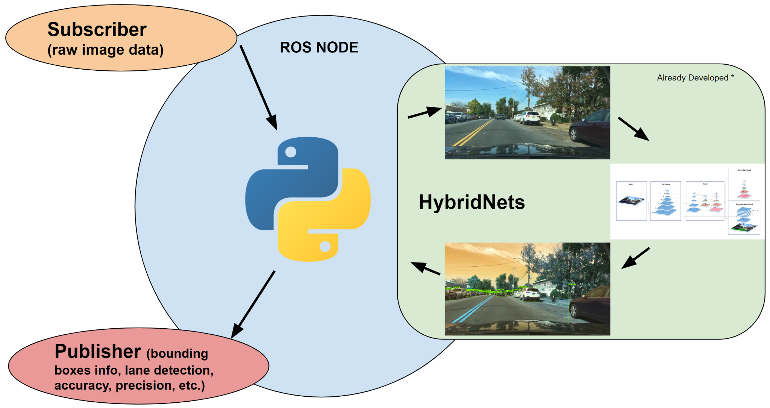
System Component
Image Conversions to Supported Format -> HybridNets -> Convert Back to ROS Supported Format
Notes:
Khai

Slide 15
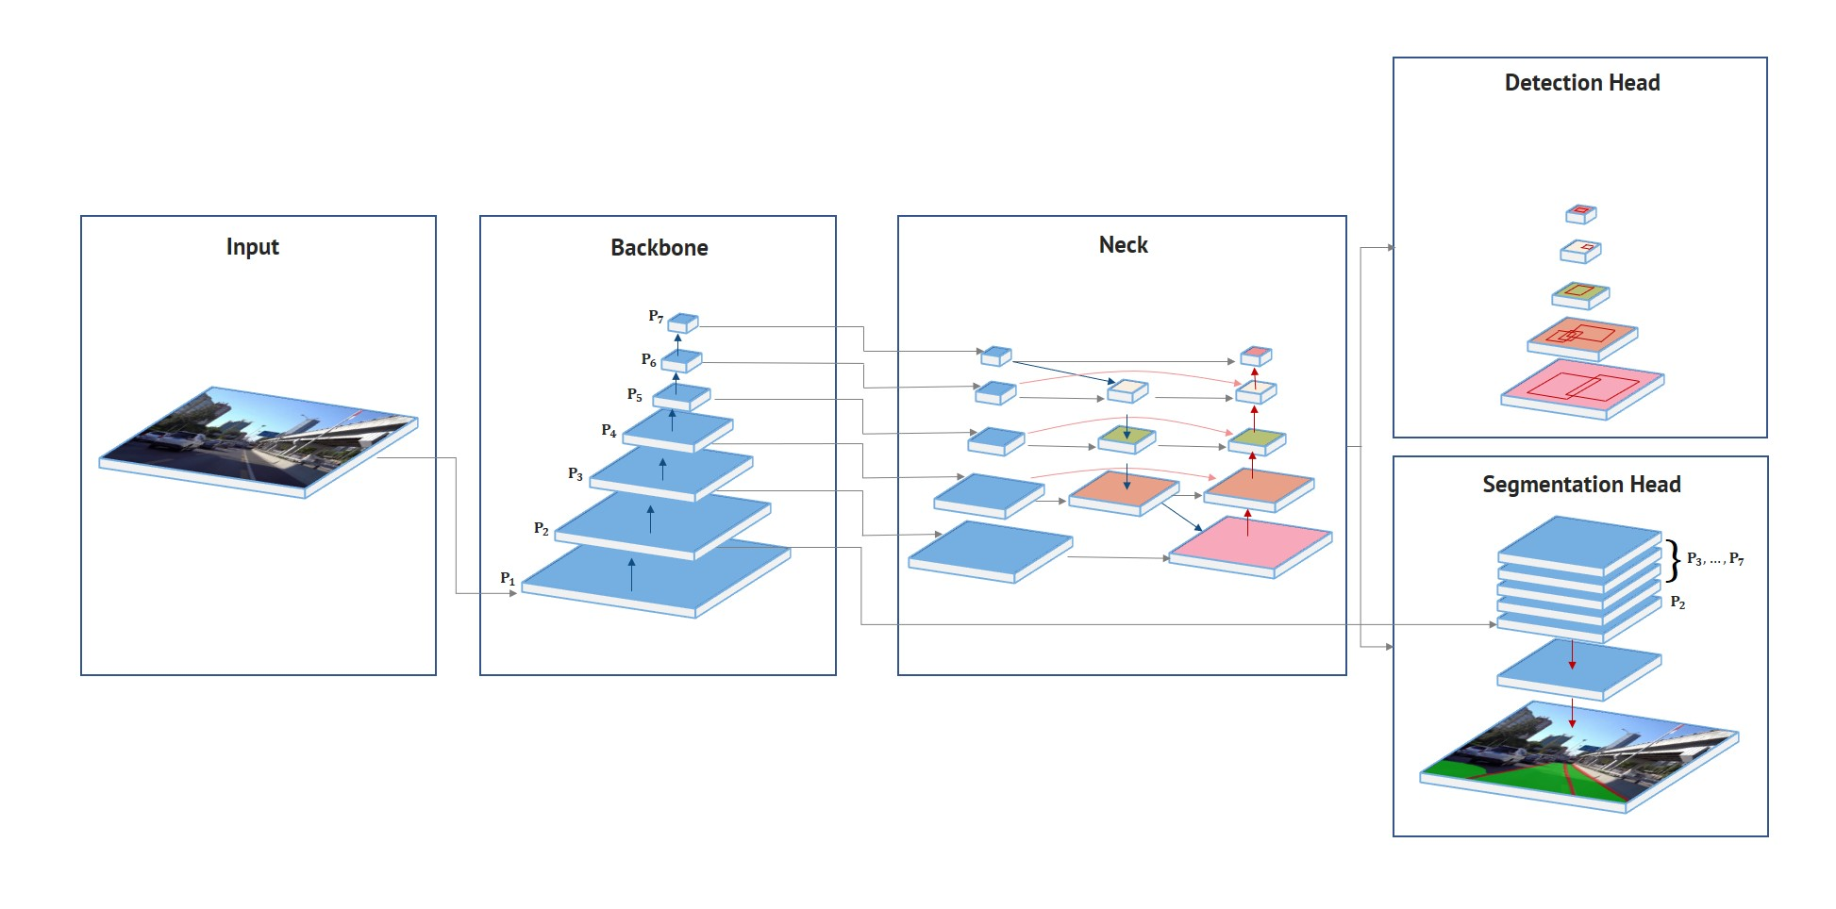
HybridNets - Machine Learning Framework
Notes:
Khai

Slide 16
5
Timeline & Project Planning
Notes:
Jason

Slide 17
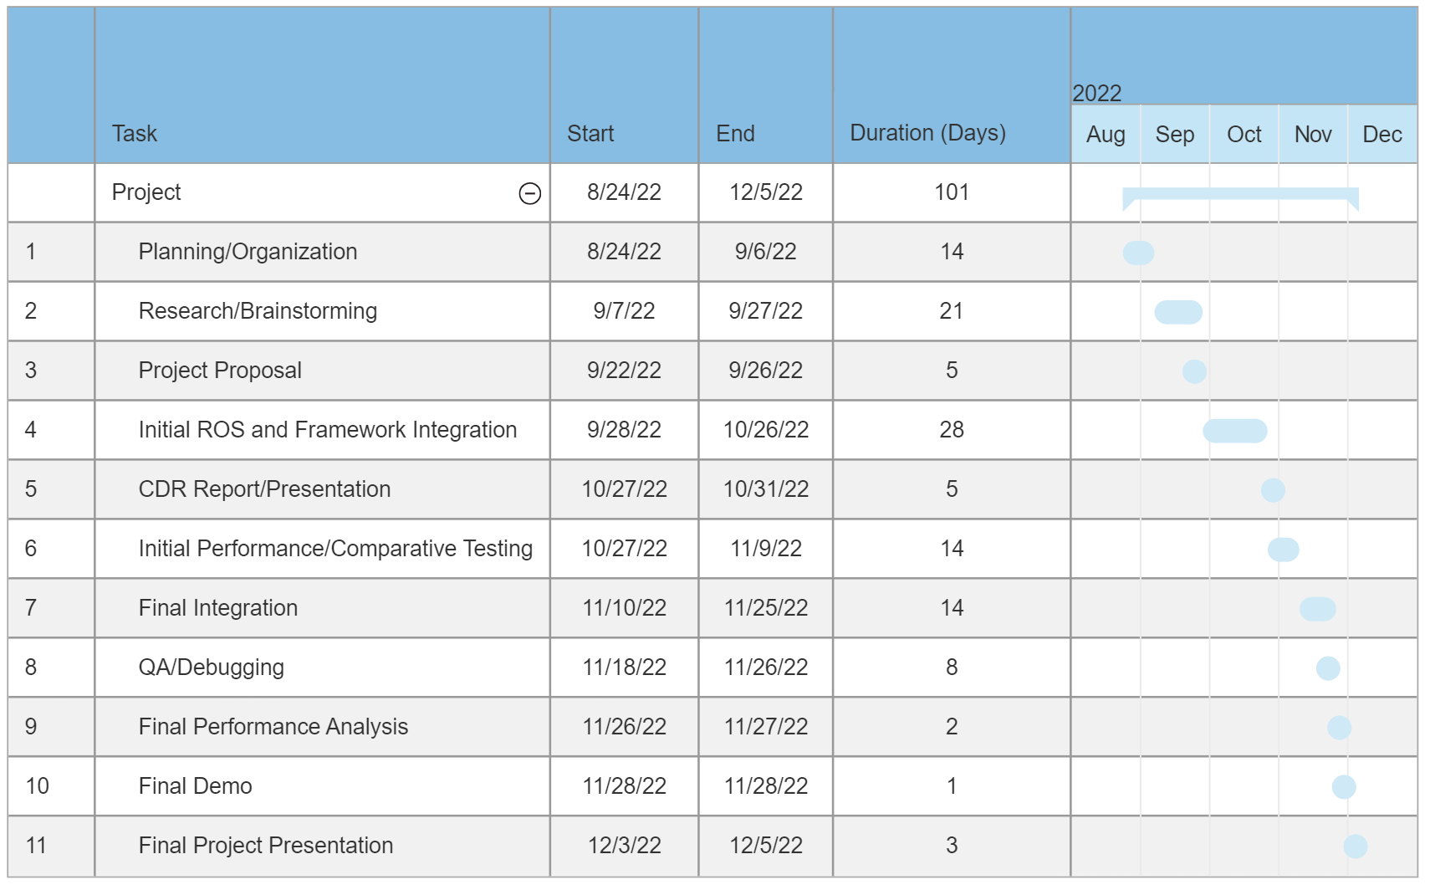
Gantt Chart of Tasks
Note: Estimation for time of completion, subject to change
Notes:
Jason

Slide 18
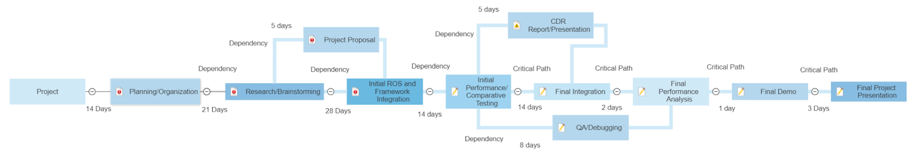
Full PERT Chart
Notes:
Jason

Slide 19
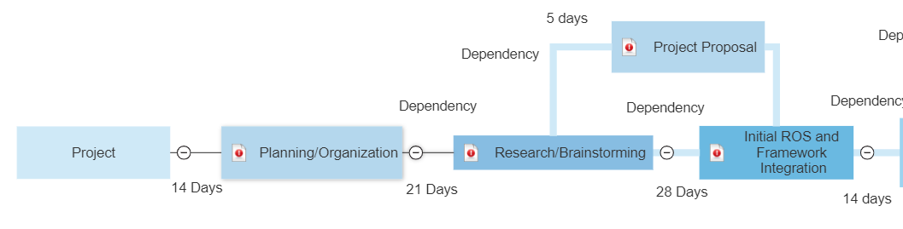
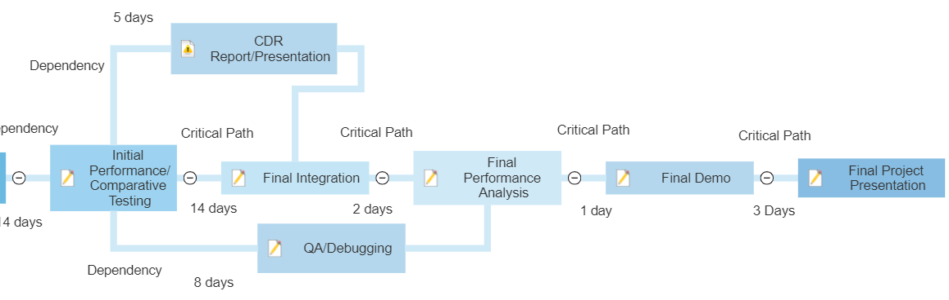
Initial/Final Stages PERT Chart
Notes:
Jason

Slide 20
Team Roles
Jason Bernal - Team Leader
Khai Nguyen - System Design
Viet Nguyen - QA/Validation
Pavan Poladi - Software Design
Weekly meetings
Weekly objectives/goals
Weekly progress updates
Notes:
Jason

Slide 21
6
Approach for Design Validation
Notes:
Pavan

Slide 22
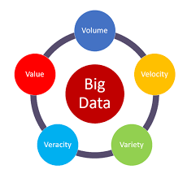

Validation 1:
Ensure we have made accurate & Robust comparisons
Use following datasets:
Provided by Instructor (BDD100K)
Included in ROS
Included in Hybrid Net
Online
Compare at least:
Speed (Most important)
Accuracy
Experience
Notes:
Pavan

Slide 23
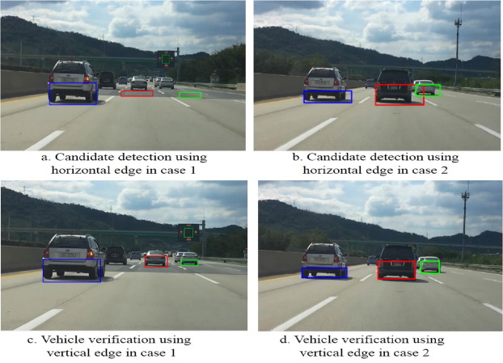
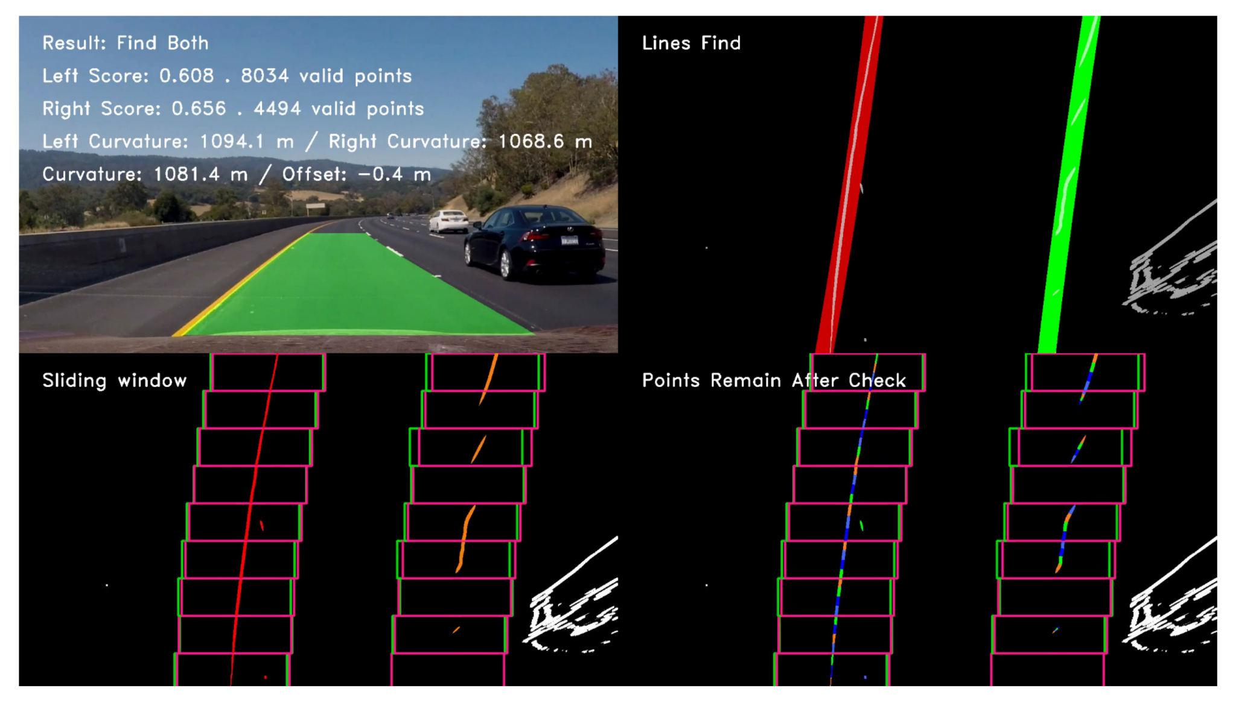
Validation 2:
New pipeline we built actually works as intended
ROS sent images to Hybrid Net
Hybrid Net received unaltered images
Hybrid Net performs correct Lane & Object Detection
Hybrid Net sends final images back to ROS
ROS receives unaltered images
Overall experience is not lost
Notes:
Pavan

Slide 24
7
Vision for Resulting Product
Notes:
khai

Slide 25

Vision for End Product
Have working python script creating gray rectangle displayed onto image in ROS GUI
Effectively understand subscriber & publisher model
Have working HybridNets model using imported modules
Ready to transfer code we created for HybridNets into ROS
After this, we need to display results onto ROS GUI
Notes:
Khai

Slide 26
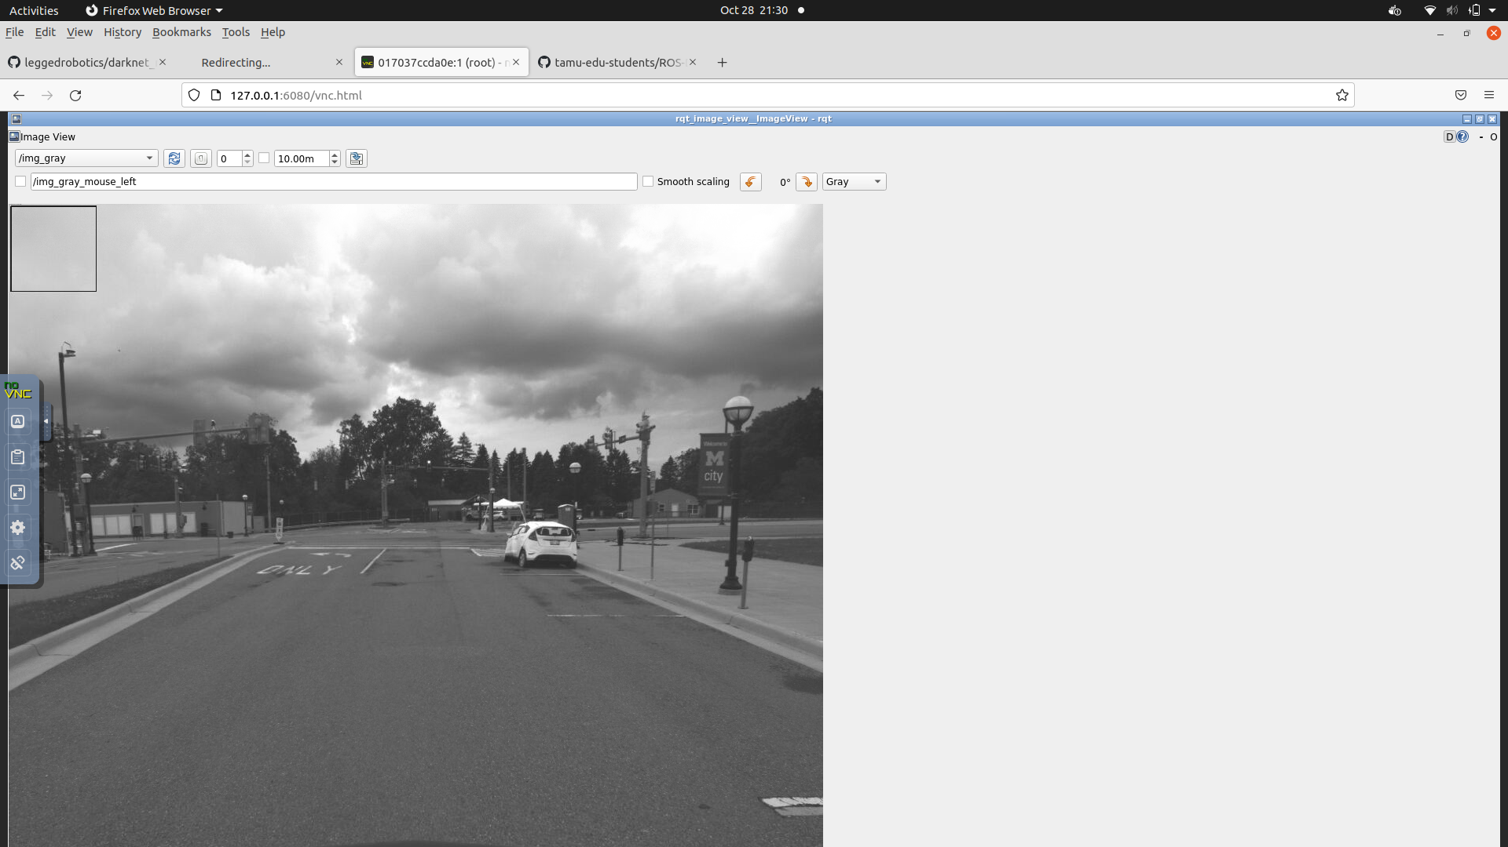
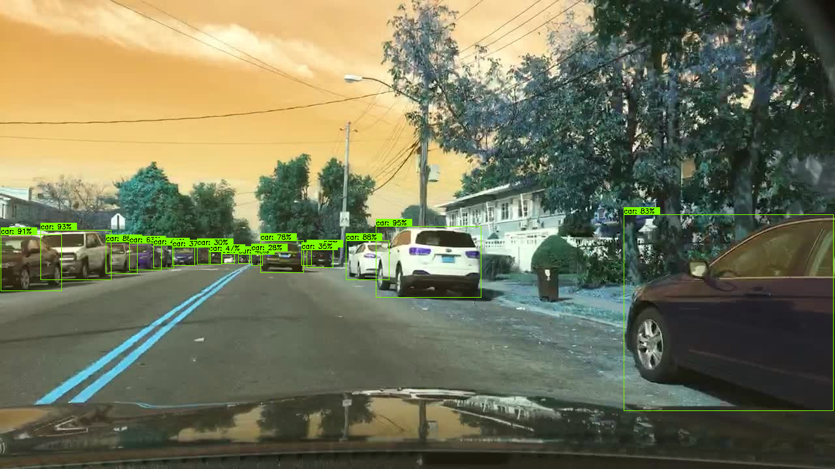
Vision for End Product Cont.
End Product:
Combine learnings from Gray box and Hybrid Nets demonstrations
Users download packages for Hybrid Nets
Users specify which data set to run model via command line
Users run the model via command line
Users see results of bounding boxes on images in ROS GUI
Users see Accuracy and speed results in the picture
Notes:
Khai
Combine learnings from Gray box and Hybrid Nets demonstrations
Users download packages for Hybrid Nets
Users specify which data set to run model via command line
Users run the model via command line
Users see results of bounding boxes on images in ROS GUI
Users see Accuracy and speed results in the picture

Slide 27
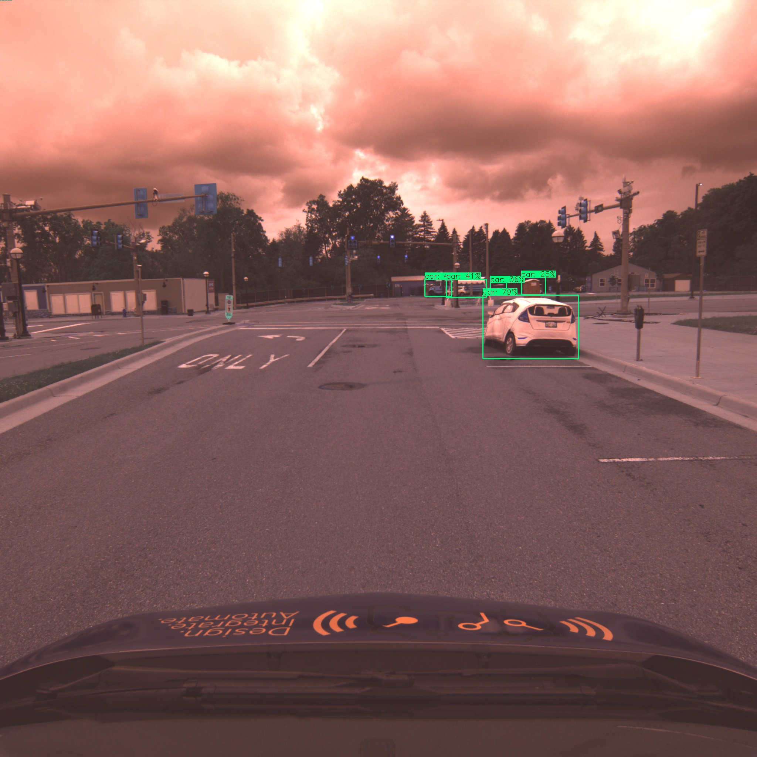
Current Progress!
Notes:
Khai

Slide 28
8
Teamwork
Notes:
Jason

Slide 29

Teamwork
Team is very collaborative and so we often interchange responsibilities.
Utilize pair programming very frequently
Meet multiple times a week
Everyone: Twice a week on Monday & Wednesday
Small Groups: As needed, usually once a week
Utilize Discord with various channels for communication
General, references, environment-setup
Voice Channels for meetings
Reward wins and take note of things not going well
Everyone is heard and helps each other
Notes:
Jason

Slide 30
9
Economic Analysis and Budget
&
Societal, Safety, and Environmental Analysis
Notes:
Viet

Slide 31
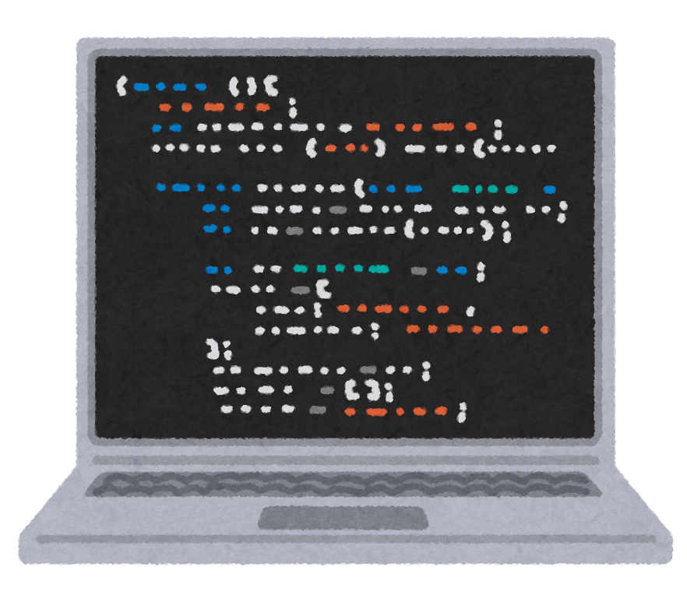


Item | Cost
External Hard drive | $50 - $100 depending on how big of files we need and such like datasets
Google Colab Labor Hours | $9.99 / month. 100 compute units per month 10hr/Week each for 10 Weeks: 400hrs
Notes:
Viet

Slide 32

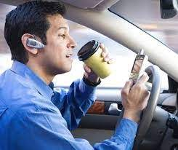


Detection of people and sidewalks
Not paying attention while driving
Free Time
Pollution
Less crashes but…
More demand for cars
Higher vehicles traveled per capita
Cars have more uptime in an ideal society
Safety and environmental analysis
Notes:
Viet

Slide 33



Political:
-Should government add economic incentives for purchasing autonomous vehicles?
-Should government offer alternative jobs for ride sharing workers
Ethics:
-Trolley Problem
-Blame the car or driver?
Social:
-Should future gen. Learn how to drive?
-Will this improve access to driving?
Social, Political, and Ethical Concerns
Notes:
Viet

Slide 34

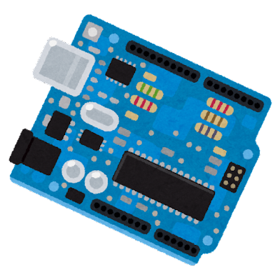

Manufacturing
Component Tolerance
microcontrollers
software version
Production
companies already makes microcontrollers
Testing
accuracy
performance
Notes:
Viet

Slide 35



Sustainability
Regulations
laws on accuracy to be street legal
Flow of Time
Better hardware, software, and technology comes
with time
System Parts
mostly just software
Notes:
Viet

Slide 36

Economic viability
Speed & Accuracy may increase but still requires a lot of money to own fast CPU, GPU, & memory to run massive datasets
Cars are a crucial part of modern life for us, and they are prevalent nearly everywhere, so large benefit for having better lane/object detection.
Autonomous cars has the extra appeal of being hybrid and electric cars
High demand - up to $70,000 for certain used electric vehicles
High upfront costs
Possible tax credits
Electric can save costs!
Notes:
Viet

Slide 37
Thanks!
ANY QUESTIONS?
Notes:
Jason

